Slide 1
DONAR Decentralized Server Selection for Cloud Services
Patrick Wendell, Princeton University
Joint work with Joe Wenjie Jiang, Michael J. Freedman, and Jennifer Rexford

Slide 2
Outline
Server selection background
Constraint-based policy interface
Scalable optimization algorithm
Production deployment

Slide 3

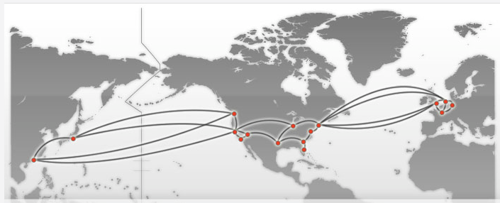
User Facing Services are Geo-Replicated

Slide 4
Reasoning About Server Selection
Client Requests
Mapping
Nodes
Service
Replicas

Slide 5

Example: Distributed DNS
Clients | Mapping Nodes | Service Replicas
DNS Resolvers
Auth. Nameservers
Servers
Client 1
DNS 1
Client 2
DNS 2
Client C
DNS 10

Slide 6
Example: HTTP Redir/Proxying
Clients | Mapping Nodes | Service Replicas
HTTP Clients
HTTP Proxies
Datacenters
Client 1
Proxy 1
Client 2
Proxy 2
Client C
Proxy 500

Slide 7
Reasoning About Server Selection
Client Requests
Mapping
Nodes
Service
Replicas

Slide 8
Reasoning About Server Selection
Client Requests
Mapping
Nodes
Service
Replicas
Outsource to DONAR

Slide 9
Outline
Server selection background
Constraint-based policy interface
Scalable optimization algorithm
Production deployment

Slide 10
Naïve Policy Choices Load-Aware: “Round Robin”
Client Requests
Mapping
Nodes
Service
Replicas

Slide 11
Naïve Policy Choices Location-Aware: “Closest Node”
Client Requests
Mapping
Nodes
Service
Replicas
Goal: support complex policies across many nodes.

Slide 12
Policies as Constraints
DONAR Nodes
Replicas
bandwidth_cap = 10,000 req/m
split_ratio = 10%
allowed_dev = ± 5%

Slide 13
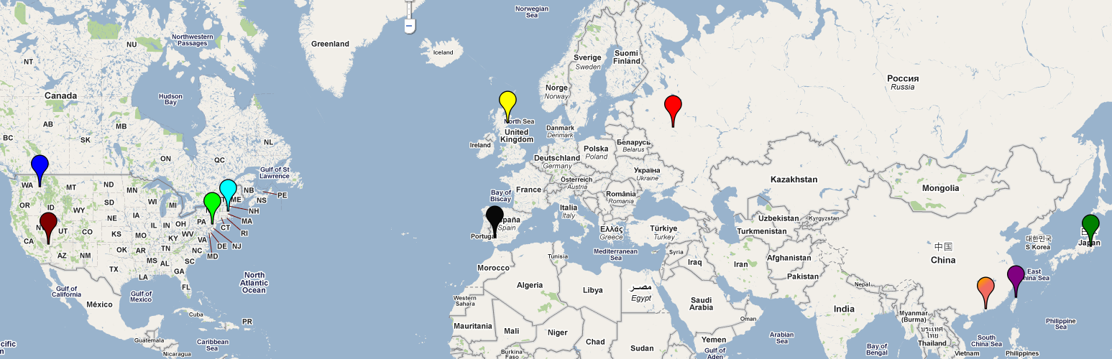
Eg. 10-Server Deployment
How to describe policy
with constraints?

Slide 14
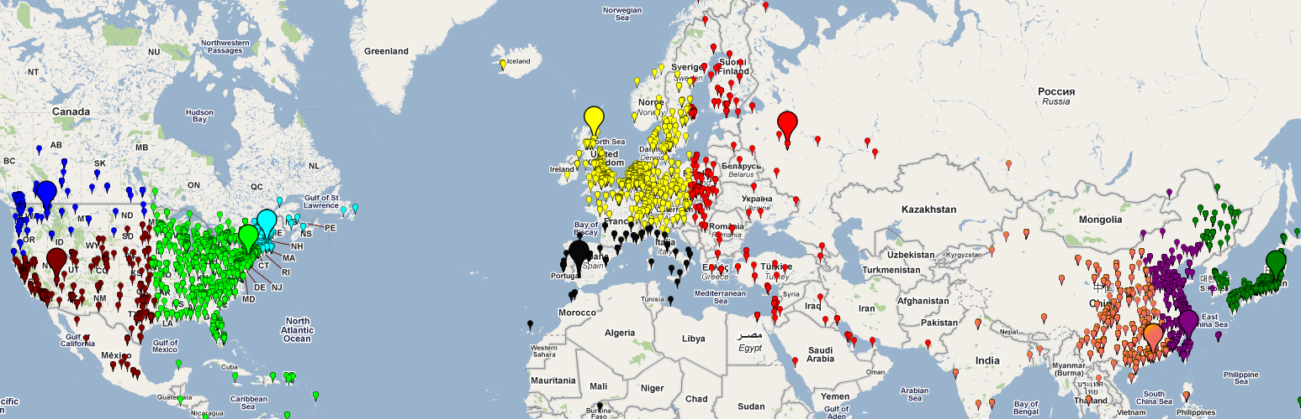
No Constraints Equivalent to “Closest Node”
Requests per Replica

Slide 15
No Constraints Equivalent to “Closest Node”
Impose 20% Cap
Requests per Replica

Slide 16
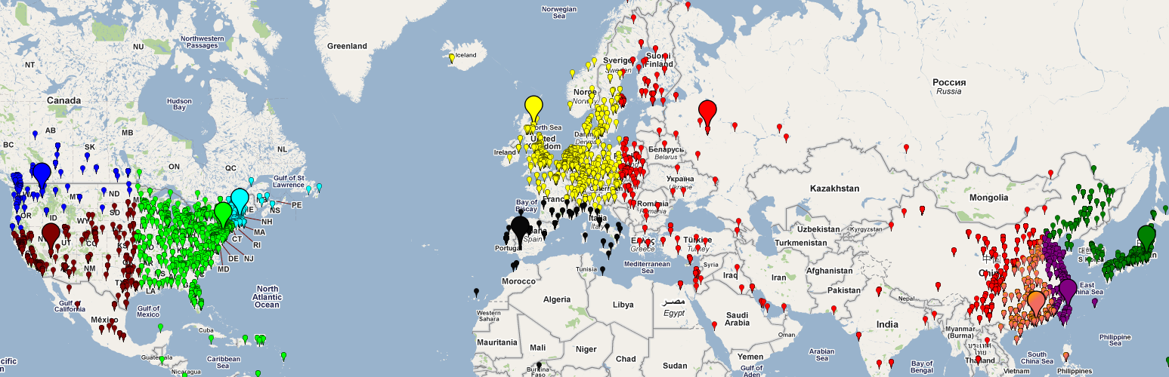
Cap as Overload Protection
Requests per Replica

Slide 17
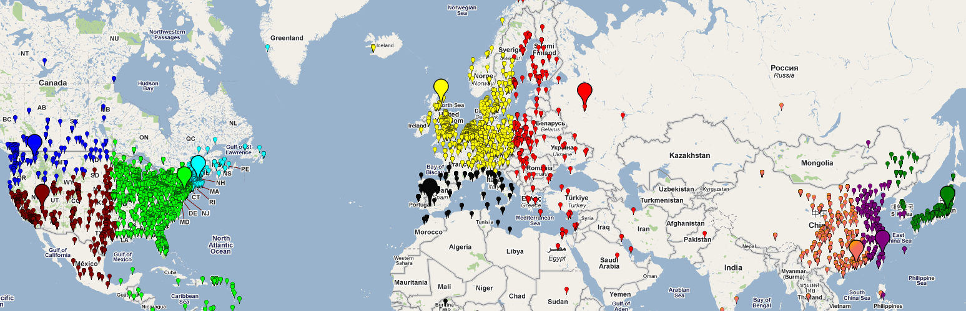
12 Hours Later…
Requests per Replica

Slide 18
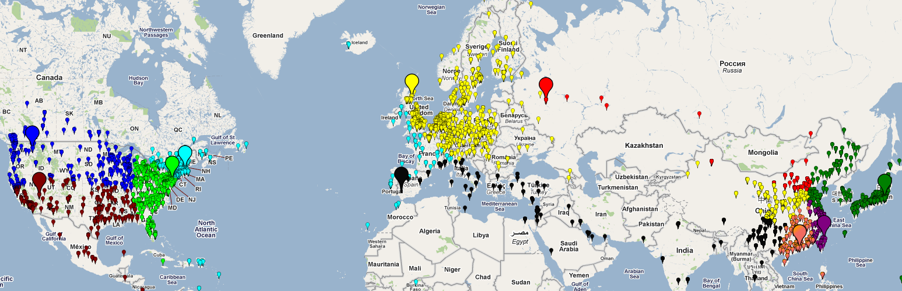
“Load Balance” (split = 10%, tolerance = 5%)
Requests per Replica

Slide 19
“Load Balance” (split = 10%, tolerance = 5%)
Trade-off network proximity & load distribution
Requests per Replica

Slide 20
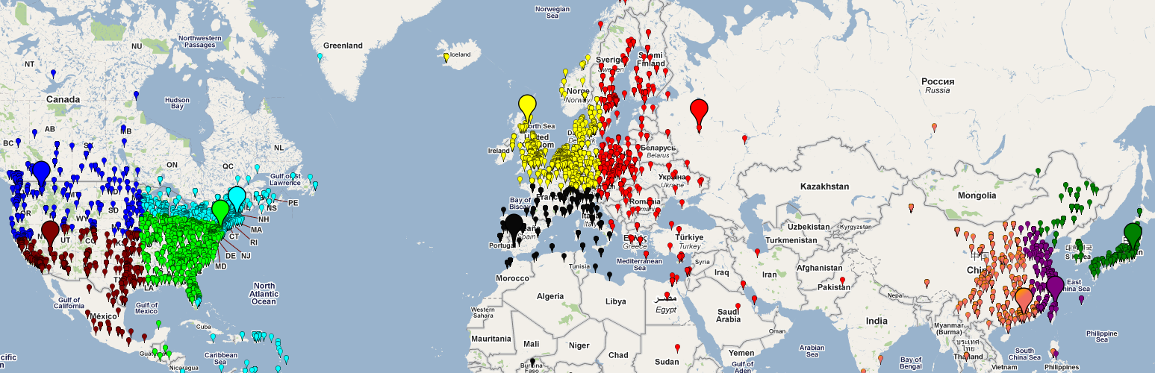
12 Hours Later…
Large range of policies by varying cap/weight
Requests per Replica

Slide 21
Outline
Server selection background
Constraint-based policy interface
Scalable optimization algorithm
Production deployment

Slide 22

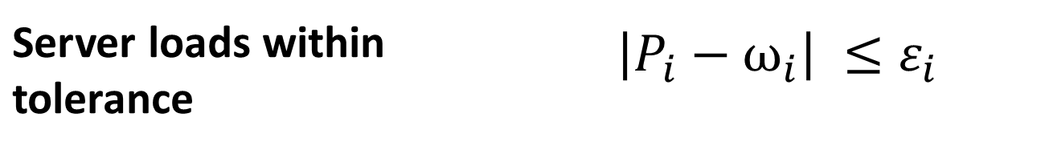
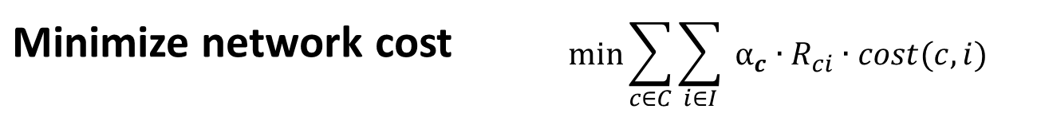
Optimization: Policy Realization
Global LP describing “optimal” pairing
Clients: c ∈ C | Nodes: n ∈ N | Replica Instances: i ∈ I
Minimize network cost | $$\min{\sum_{c∈C}{\sum_{i∈I}{ {α_{c}∙R}_{ci}∙cost(c, i)}}}$$
s.t.
Server loads within tolerance | $$\left|P_{i}−ω_{i}\right| ≤ε_{i}$$
Bandwidth caps met | $$B_{i}<B∙P_{i}$$

Slide 23
Optimization Workflow
Measure Traffic
Track Replica Set
Calculate Optimal Assignment

Slide 24
Optimization Workflow
Measure Traffic
Track Replica Set
Calculate Optimal Assignment
Per-customer!

Slide 25
Optimization Workflow
Measure Traffic
Track Replica Set
Calculate Optimal Assignment
Continuously!
(respond to underlying traffic)

Slide 26
By The Numbers
 | 10¹ | 10² | 10³ | 10⁴
DONAR Nodes
Customers
replicas/customer
client groups/ customer
Problem for each customer:
10² * 10⁴ = 10⁶

Slide 27
Measure Traffic & Optimize Locally?
Mapping
Nodes
Service
Replicas

Slide 28
Not Accurate!
Client Requests
Mapping
Nodes
Service
Replicas
No one node sees
entire client population

Slide 29
Aggregate at Central Coordinator?
Mapping
Nodes
Service
Replicas

Slide 30
Aggregate at Central Coordinator?
Mapping
Nodes
Service
Replicas
Share Traffic
Measurements
(10⁶)

Slide 31
Aggregate at Central Coordinator?
Mapping
Nodes
Service
Replicas
Optimize

Slide 32
Aggregate at Central Coordinator?
Mapping
Nodes
Service
Replicas
Return
assignments (10⁶)

Slide 33
So Far
 | Accurate | Efficient | Reliable
Local only | No | Yes | Yes
Central Coordinator | Yes | No | No

Slide 34




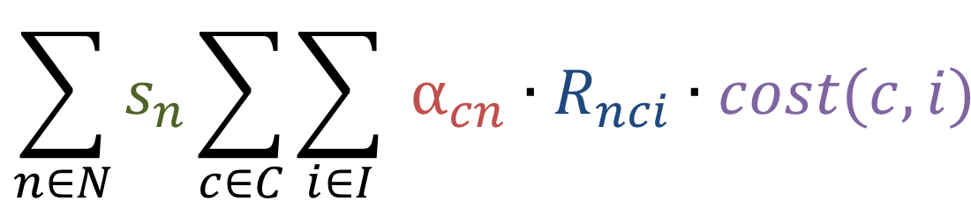
Decomposing Objective Function
Traffic from c
cost of mapping c to i
$$\min{\sum_{c∈C}{\sum_{i∈I}{ {α_{c}∙R}_{ci}∙cost(c, i)}}}$$
We also decompose constraints (more complicated)
prob of mapping c to i
$$∀ clients$$
$$∀ instances$$
=
$$\sum_{n∈N}{s_{n}\sum_{c∈C}{\sum_{i∈I}{ {α_{cn}∙R}_{nci}∙cost(c, i)}}}$$
$$∀ nodes$$
Traffic to this node

Slide 35

Decomposed Local Problem For Some Node (n*)
load_{i} = f(prevailing load on each server + load I will impose on each server)
$${{∀_{i}load}_{i} + s}_{n^{∗}}\sum_{c∈C}{\sum_{i∈I}{ {α_{cn^{∗}}∙R}_{n^{∗}ci}∙cost\left(c, i\right)}}$$
min
Global load
information
Local distance minimization

Slide 36
DONAR Algorithm
Solve local problem
Mapping
Nodes
Service
Replicas

Slide 37
DONAR Algorithm
Solve local problem
Mapping
Nodes
Service
Replicas
Share summary data
w/ others
(10²)

Slide 38
DONAR Algorithm
Mapping
Nodes
Service
Replicas
Solve local problem

Slide 39
DONAR Algorithm
Mapping
Nodes
Service
Replicas
Share summary
data w/ others (10²)

Slide 40
DONAR Algorithm
Mapping
Nodes
Service
Replicas
Provably converges to global optimum
Requires no coordination
Reduces message passing by 10⁴

Slide 41
Better!
 | Accurate | Efficient | Reliable
Local only | No | Yes | Yes
Central Coordinator | Yes | No | No
DONAR | Yes | Yes | Yes

Slide 42
Outline
Server selection background
Constraint-based policy interface
Scalable optimization algorithm
Production deployment

Slide 43



Production and Deployment
Publicly deployed 24/7 since November 2009
IP2Geo data from Quova Inc.
Production use:
All MeasurementLab Services (incl. FCC Broadband Testing)
CoralCDN
Services around 1M DNS requests per day

Slide 44
Systems Challenges (See Paper!)
Network availability Anycast with BGP
Reliable data storage Chain-Replication with Apportioned Queries
Secure, reliable updates Self-Certifying Update Protocol

Slide 45
CoralCDN Experimental Setup
split_weight = .1 tolerance = .02
Client Requests
DONAR Nodes
CoralCDN
Replicas

Slide 46
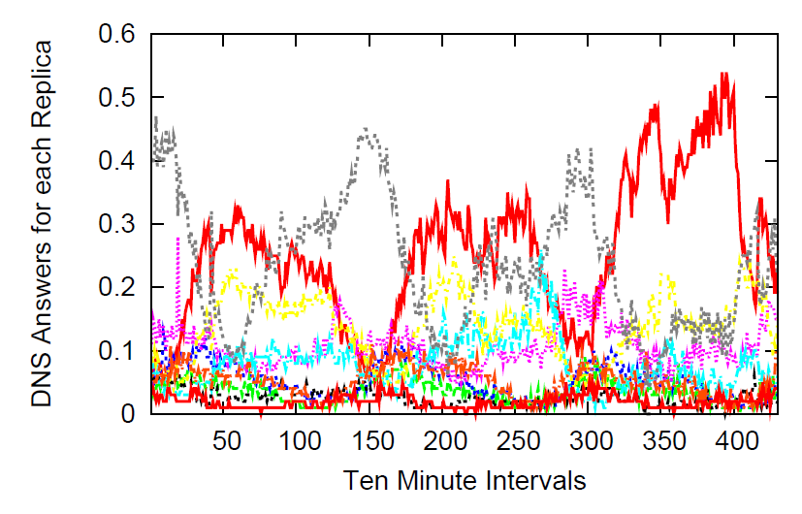
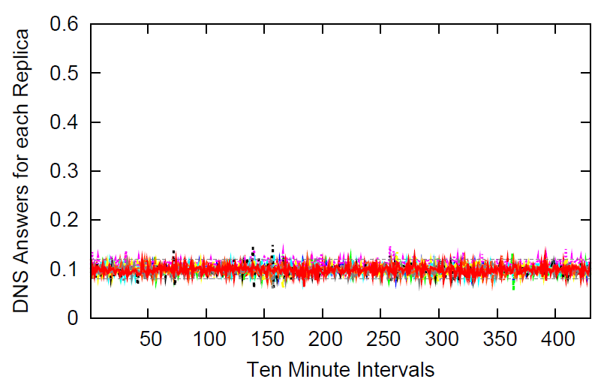
Results: DONAR Curbs Volatility
“Closest Node” policy
DONAR “Equal Split” Policy

Slide 47
Results: DONAR Minimizes Distance

Slide 48
Conclusions
Dynamic server selection is difficult
Global constraints
Distributed decision-making
Services reap benefit of outsourcing to DONAR.
Flexible policies
General: Supports DNS & HTTP Proxying
Efficient distributed constraint optimization
Interested in using? Contact me or visit http://www.donardns.org.

Slide 49
Questions?

Slide 50
Related Work (Academic and Industry)
Academic
Improving network measurement
iPlane: An informationplane for distributed services H. V. Madhyastha, T. Isdal, M. Piatek, C. Dixon, T. Anderson, A. Krishnamurthy, and A. Venkataramani, “,” in OSDI, Nov. 2006
“Application Layer Anycast”
OASIS: Anycast for Any Service Michael J. Freedman, Karthik Lakshminarayanan, and David Mazières Proc. 3rd USENIX/ACM Symposium on Networked Systems Design and Implementation (NSDI '06) San Jose, CA, May 2006.
Proprietary
Amazon Elastic Load Balancing
UltraDNS
Akamai Global Traffic Management

Slide 51
Doesn’t [Akamai/UltraDNS/etc] Already Do This?
Existing approaches use alternative, centralized formulations.
Often restrict the set of nodes per-service.
Lose benefit of large number of nodes (proxies/DNS servers/etc).

